Slide 1



ANÁLISIS ECODEMOGRAFICO EN MÉXICO PARA UN SISTEMA RECOMENDADOR DE MICRONEGOCIOS
Authors:
Dr. Heriberto Casarrubias Vargas
Oscar Suarez Nava

Slide 2

What context do we have?
Currently we focus on the importance of the local economy of a country.
The imicroeconomic development has a high impact on the care of the family economy in Mexico.
Offering some type of service or from which profits can be generated to meet the economic needs., this generated to carry out family businesses or micro-businesses.

Slide 3
So what is the problematic?
Idea of Micro-Business
Due to the importance of micro businesses in local, state, and national economies, and particularly for the entrepreneur, deciding on the right venture is a challenge that is conditioned by the needs to achieve an objective.
Apply Model Of Business
criteria
UNSUCESSFULL
SUCESSFULL

Slide 4

The proposal made Recommender system
Based us on the analysis of eco-demographic data on the study of micro businesses through the different economic censuses carried out in Mexico.
Develop a recommended micro-business system that considers current environments of success, as well as different key characteristics helping to define a survival threshold.

Slide 5
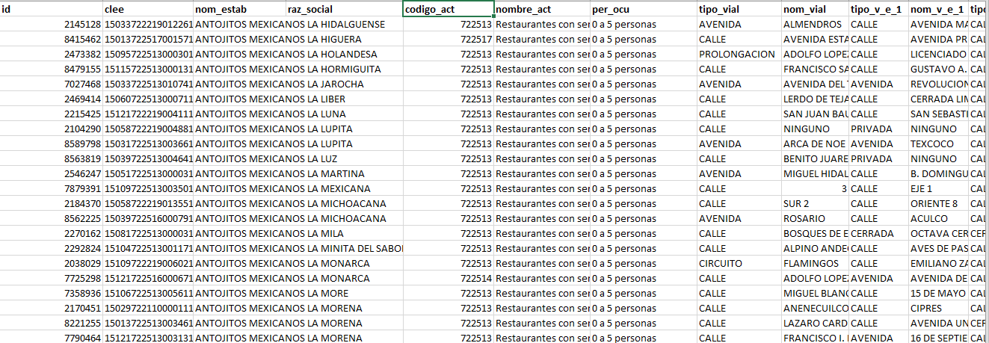
METHODOLOGY
1.- Data extraction:
To form this research proposal, it is initially intended to search for descriptive values of location, population mobility, population density, type of microbusiness service (see example in Figure 1).

Slide 6
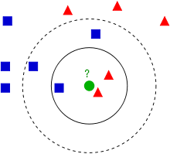
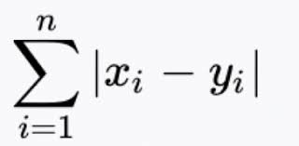
METHODOLOGY
2.- Data analysis and classification
This conformation of indicators will serve to find clusters or groups by type of business to infer the appropriate conditions for the implementation of businesses in other locations with similar conditions.
Making use of the knn algorithm

Slide 7
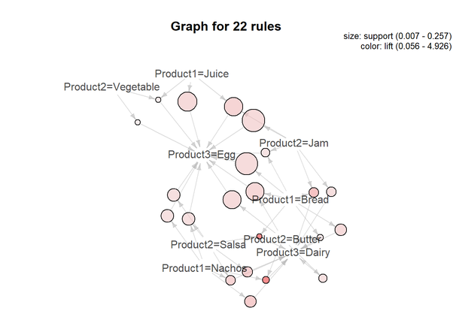
METHODOLOGY
3.- Data structuring/organization:
This summarize most of the information contained in the original feature set.
Where we apply tecnical "Basket analisis"

Slide 8
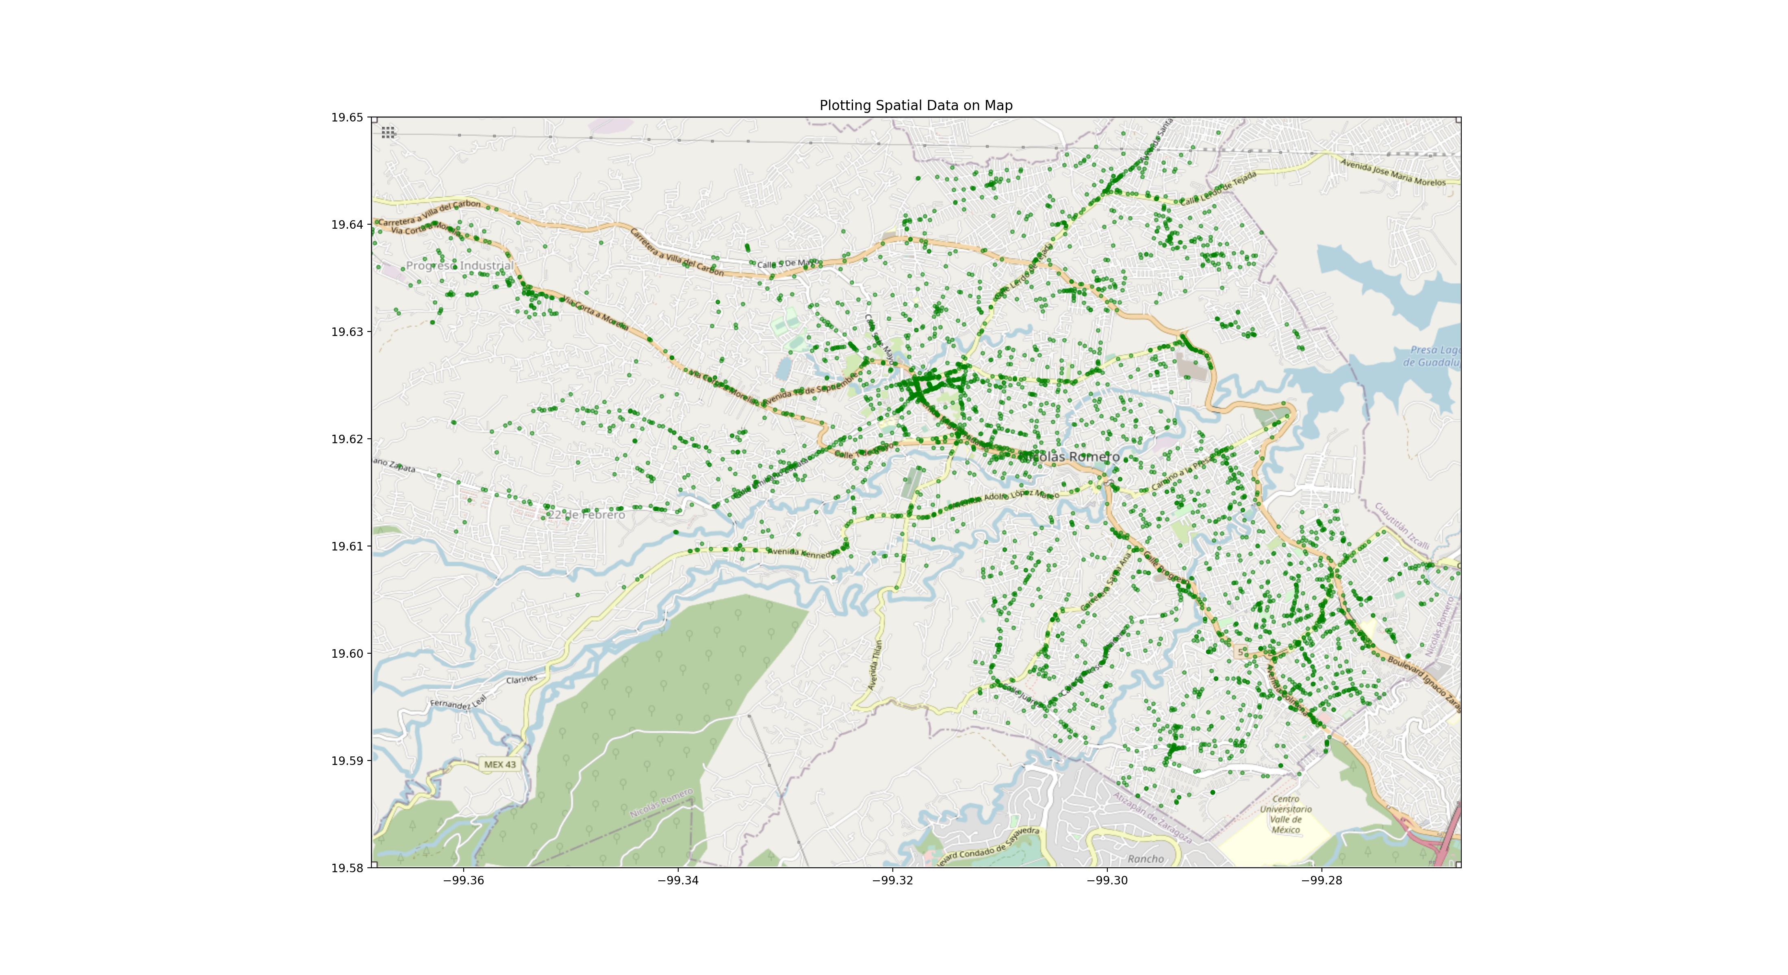
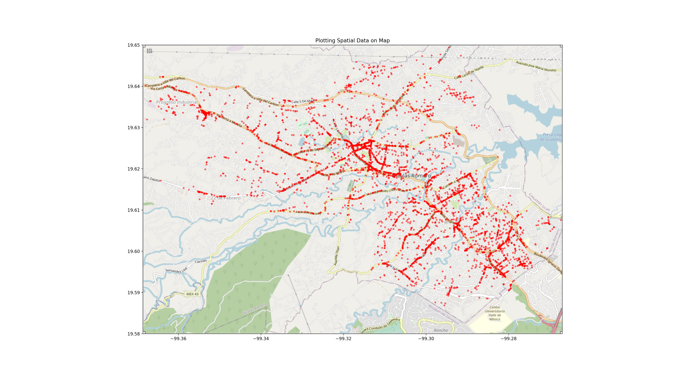
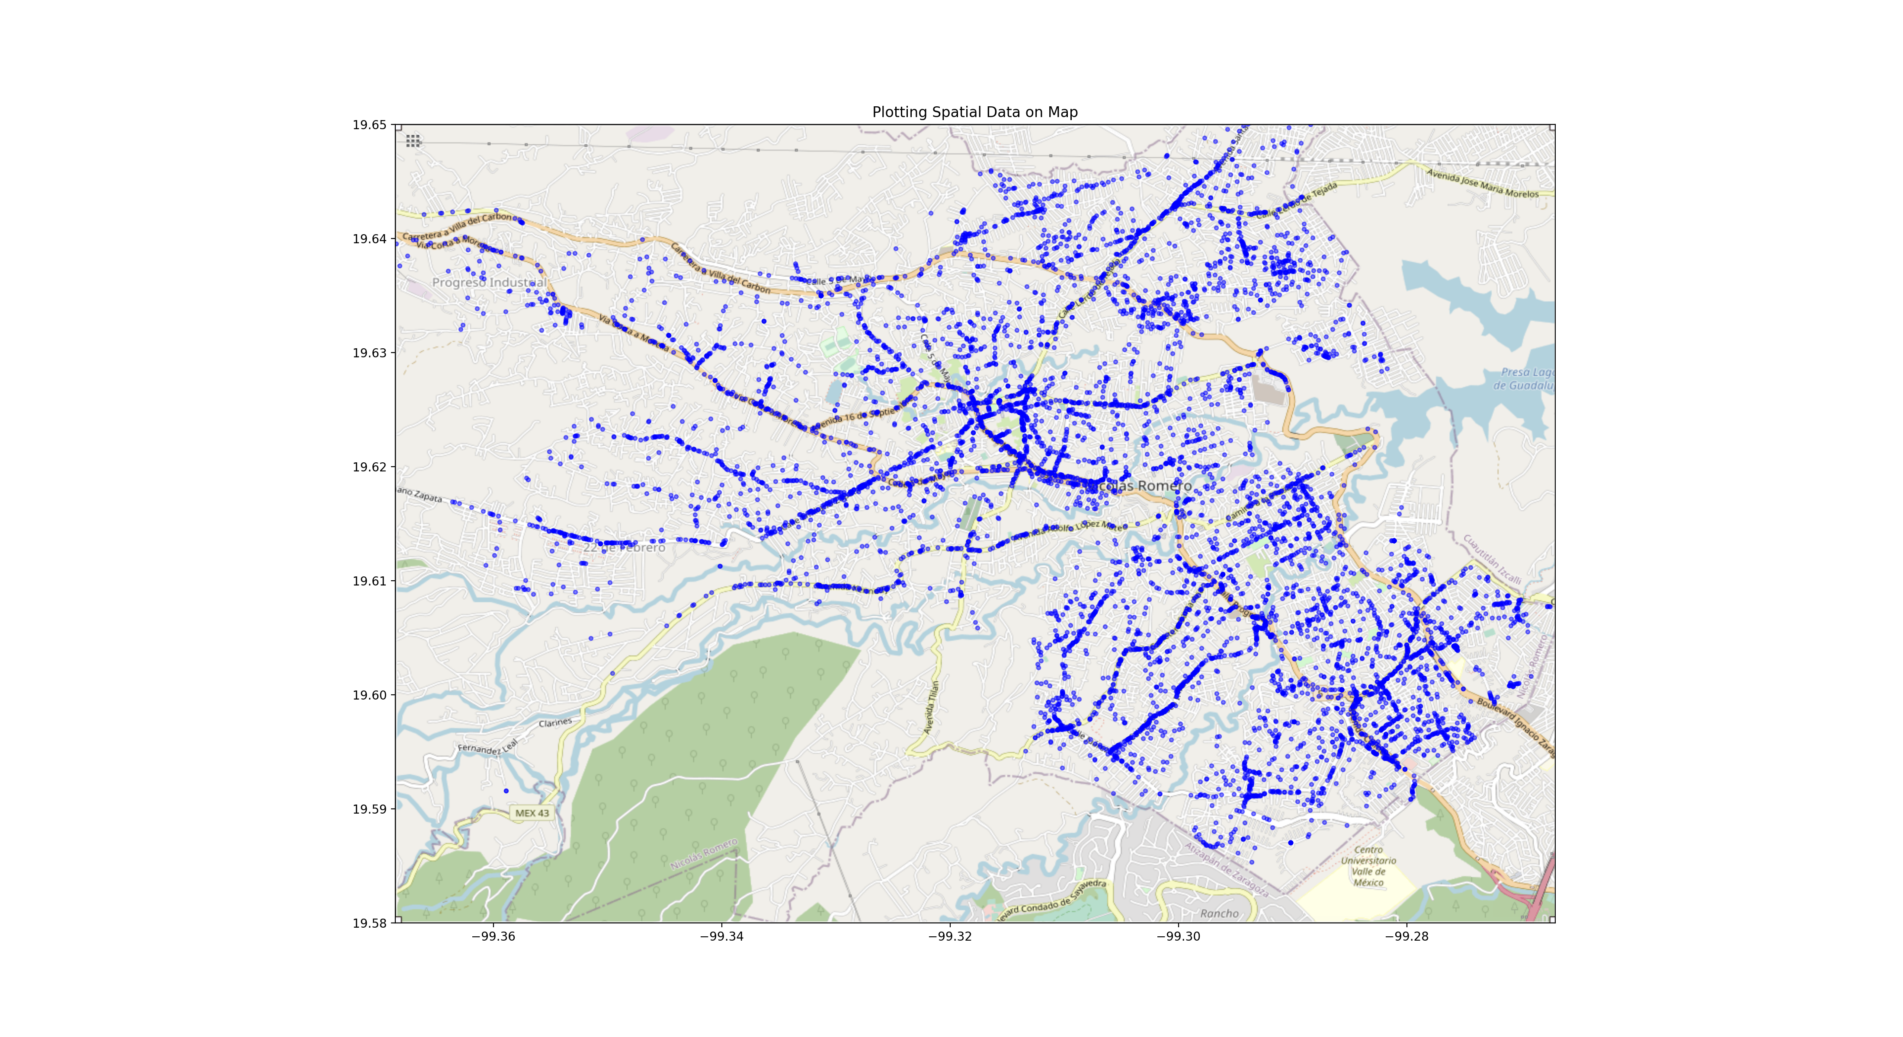
Implementing Analysis PLOT MICROBUSINESS
Location: Nicolas Romero,Edo.México
cut time MicroBussines < 2014-12
2014-12 <cut time MicroBussines < 2019-11
cut time MicroBussines < 2019-11

Slide 9
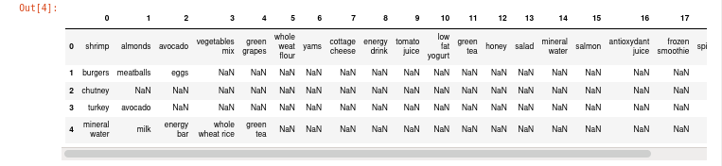
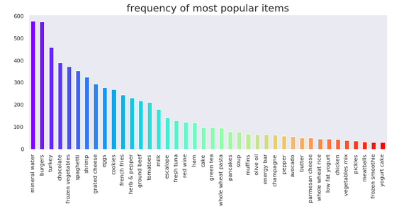
Construct recommendations
They will obtain tendencies of products or services generally demanding you with great frequency in the face of a growing population density in a region, what can you tell us; if the type of service or product offered by a microbusiness is related to the stability that can be achieved.

Slide 10
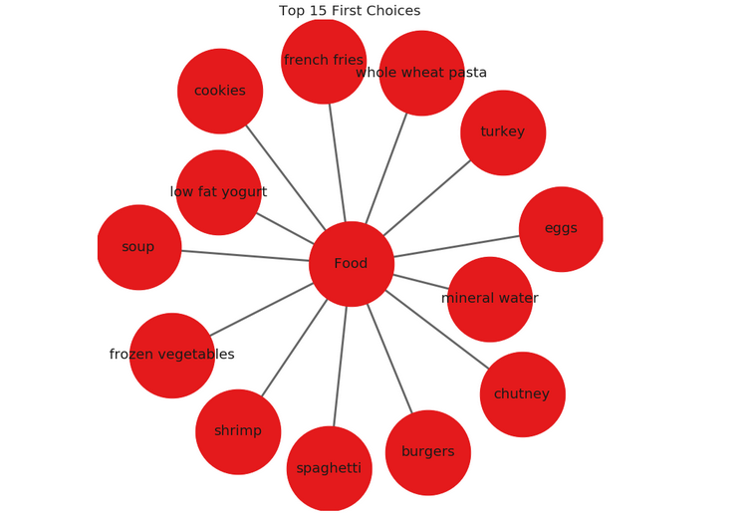
FINALY WE getting THE RECOMEDATION
As a final product, when obtaining defined models, a recommendation system is developed, with functionality that estimates the life expectancy of the microbusiness, considering the characteristics of the locality and contrasting with localities that have the same eco-demographic characteristics.

Slide 11
SO THAT IS ALL!
!Thanks for your attentions!

